Slide 1
Solution Core AI Website Project
Product Manager Project Documentation
Project Overview
Product: Solution Core AI Business Website
Goal: Create a professional digital presence for Solution Core AI that clearly communicates services, generates leads, builds credibility, and provides an easy path for potential customers to contact the company.
Success Metrics:
Professional online presence established
Visitors understand services within 10 seconds
Clear contact pathway available
Mobile-responsive experience
Customer engagement through chatbot
Lead generation capability

Slide 2
Product Manager Responsibilities
Discovery Phase
Business Problem Identification
Observed Problems:
No central online presence
Services not clearly communicated
No lead capture mechanism
No AI-focused company branding
Limited customer discovery process
Market Research
Activities:
Review AI consulting websites
Analyze competitor positioning
Evaluate consulting company landing pages
Research chatbot best practices
PM Deliverables:
Competitive Analysis
Market Positioning Document
Opportunity Assessment
Tools:
SWOT Analysis
Competitor Matrix
Customer Journey Mapping
PM Deliverables:
Problem Statement
Business Goals
Stakeholder Requirements
Success Metrics
Tools Used:
Stakeholder Interviews
Business Requirement Document (BRD)
Product Vision Statement

Slide 3
Product Strategy
Vision:
Provide businesses with a simple and professional way to discover AI consulting, automation, digital marketing, web development, and product consulting services.
Target Users:
Small businesses
Startups
Professional service companies
Healthcare organizations
Technology companies
Prioritized Features:
Homepage
Service Catalog
Product Showcase
Industry Focus
Contact Page
Chatbot
Social Media Integration
Methodology:
Agile Product Development
Product Backlog Prioritization
MVP Approach

Slide 4
Product Requirements Document (PRD)
Feature 1: Homepage Hero Section
Requirement:
Company logo
Value proposition
CTA buttons
Mobile responsive
Priority: High
Feature 2: Solutions Section
Requirement:
AI Consulting
Automation
Marketing
Web Development
Priority: High
Feature 4: Customer Support Chatbot
Requirement:
Open and close functionality
Professional greeting
Quick action buttons
Business service responses
Priority: Medium
Feature 3: Products Section
Requirement:
AI Marketing Assistant
Product Management Consulting
Agile Enterprise Consulting
Business Chatbot
Priority: Medium

Slide 5
User Stories
US-001
As a visitor, I want to understand Solution Core AI services, so that I can determine whether the company can help my business.
US-002
As a prospective customer, I want an easy way to contact the company, so that I can request a consultation.
US-003
As a website visitor, I want to ask questions through a chatbot, so that I can quickly learn about available services.

Slide 6
Product Backlog
High Priority
Website structure
Navigation
Service descriptions
Contact section
Medium Priority
Chatbot
Social links
Product cards
Future Enhancements
CRM integration
AI-powered chatbot
Analytics dashboard
Customer testimonials
Online scheduling
Sprint Planning
Sprint 1 Duration: 1 Week
Tasks:
Define scope
Create requirements
Establish information architecture
Deliverables:
PRD
Site map
Wireframes
Sprint 2 Duration: 1 Week
Tasks:
Homepage
Navigation
Branding
Deliverables:
MVP homepage
Sprint 3 Duration: 1 Week
Tasks:
Services
Products
Industries
Deliverables:
Core website content

Slide 7
PM Day-to-Day Activities
Daily Activities:
Review project progress
Prioritize backlog
Clarify requirements
Remove blockers
Coordinate design and development
Conduct stakeholder reviews
Track project timeline
Approve deliverables
Meetings:
Daily Standup
Sprint Planning
Backlog Refinement
Sprint Review
Retrospective
Sprint 4 Duration: 1 Week
Tasks:
Chatbot
Contact page
Testing
Deliverables:
Production-ready website
Tools Used By Product Manager
Planning:
Jira
Azure DevOps
Trello
Documentation:
Confluence
Notion
Google Docs
Communication:
Slack
Teams
Zoom
Analytics:
Google Analytics
Hotjar
Design Collaboration:
Figma
Miro
Project Tracking:
Excel
Smartsheet
Microsoft Project

Slide 8
Project Outcome
Delivered:
Fully functional Solution Core AI website
Responsive design
AI-focused branding
Service showcase
Customer support chatbot
Contact mechanism
Social media integration
Result: Established a professional digital platform to support customer acquisition, brand awareness, and future business growth.

Slide 9
Week | Activity
Week 1 | Discovery & Requirements
Week 2 | Product Strategy & Wireframes
Week 3 | UI/UX Design
Week 4 | Development Sprint 1
Week 5 | Development Sprint 2
Week 6 | Chatbot & Testing
Week 7 | QA & Stakeholder Review
Week 8 | Launch

Slide 10
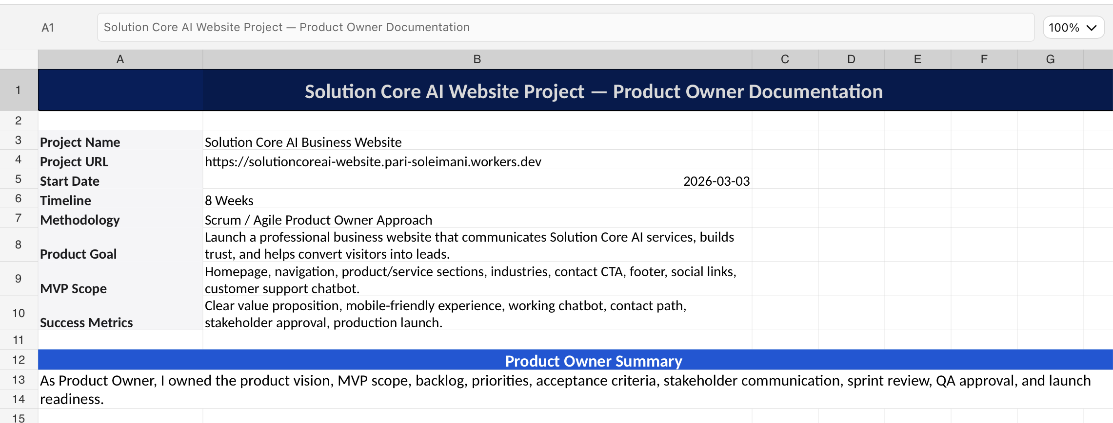

Slide 11
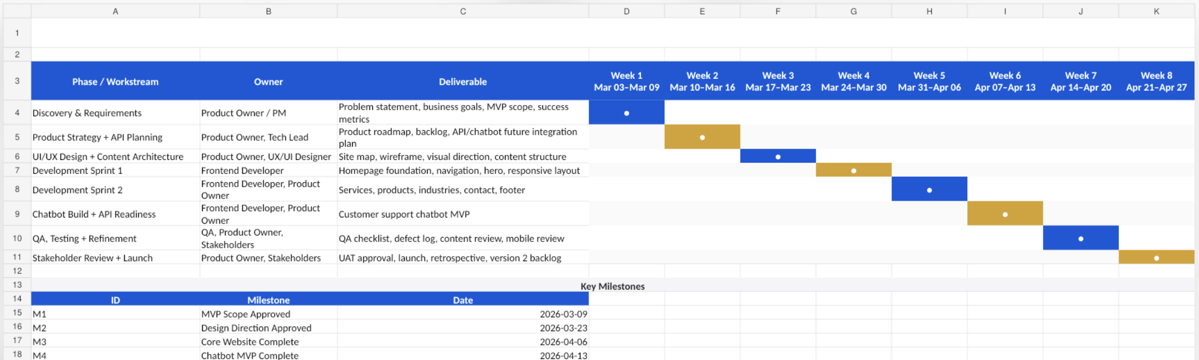
Gantt Chart Image

Slide 12
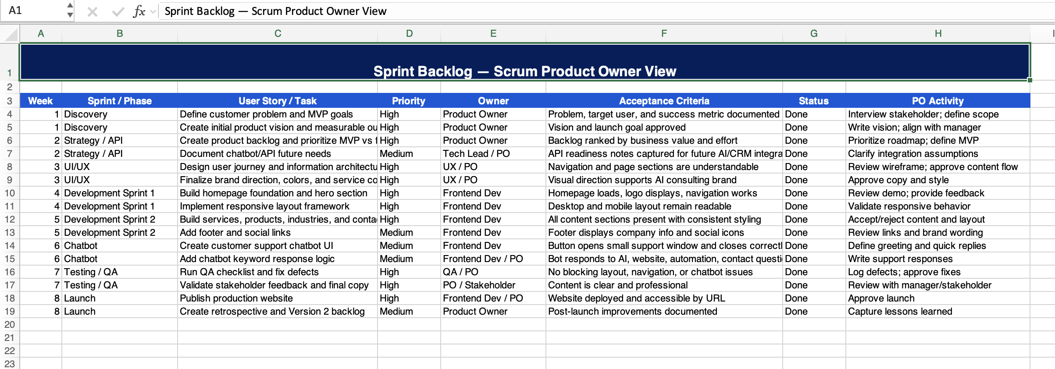

Slide 13
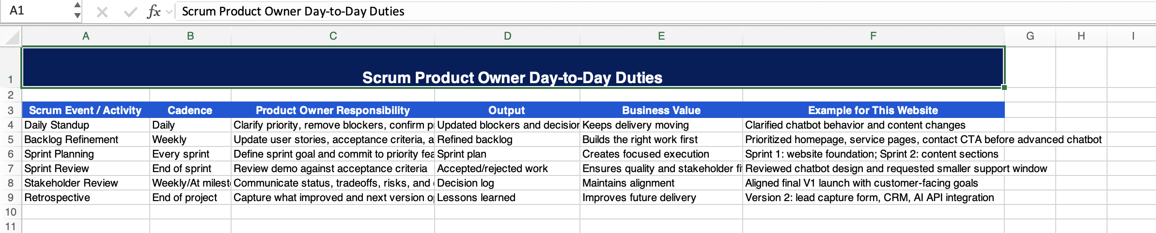

Slide 14
